Slide 1

Postman automation
1) Manual Testing
2)Automation

Slide 2



Why we need AUtomation?
1)Reduces Repetitive manual work.
Ex:
2)will get instant feed backs when something doesn't work.
Ex:
3)Identify software bugs early in the development.
Ex: production

Slide 3
Postman supported Automation testing
1.Automation with Newman.
2 .Automation with collection Runner
3.monitors.

Slide 4
What is Newman?
Newman is a CLI tool which allows you to run a postman collection directly from command line
We can't run the postman itself because it’s a tool. We need a tool between postman collections and runs the test inside and give us the information as we expect.
Newman fills this gap.

Slide 5
Newman
To run Newman we need
1) node.js
2) NPM(node packet manager)
Installed NPM,CLI in my system.
Newman run URL on CMD prompt.

Slide 6
Examples of what we run on Newman cli
Travis CI
Jenkins API
Any other cli server
Git labs
bamboos

Slide 7
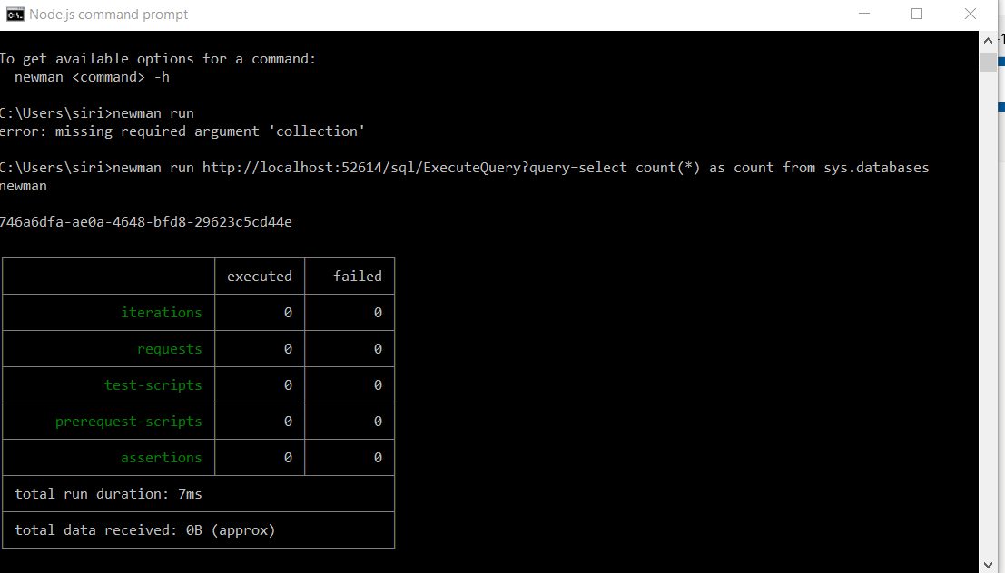

Slide 8
2) collection runner
What is collection?
Postman collection is a platform where any one can find hundreds of API collections.
What is Collection Runner?
Postman’s Collection Runner is a powerful tool. As its name implies, the Collection Runner (CR) lets you run all requests inside a Postman collection one or more times.
Collection runner runs all request is the collection or folder.

Slide 9
Collection runner:
It used to check the test case whether they passed or not using csv, json.
Cookies stored in the cookie manager.
Add collection
Run the test.
In the console you see two options:
Iterations : An iteration number is the number of times the same requests will run. For example iteration set as 3 will run all the requests 3 times. Set it as 2.
Delay : A delay time is the time to wait between any two iterations. A delay time of 10ms will mean that Postman will wait 10ms after running one iteration before the second iteration. Set it as 5ms.

